Slide 1
PC Cement Hydration
Notes:
PCC consists of binder and aggregates. Aggregates are typically used in two factions: fines and coarse.
The binder phase normally controls the strength of the concrete. Aggregates normally serve as the filler but help to reduce shrinkage (at early ages) and creep (at later ages). Aggregates also influence the modulus of elasticity.
Discussion of cementitious phase will focus on mechanical, chemical, and physical properties. Concrete phase will focus on early age characteristics, chemical admixtures, and hardened concrete properties.

Slide 2
Introduction
Portland Cement Concrete
Continous binder phase: the cementitious matrix
      Binder effect on PCC behavior
      Affects permeability
      Affects strength
    Dispersed particulate phase: the aggregates
      Coarse: #4 to 1½”
      Fine: #100 to #4
      Aggregates have a major effect on PCC behavior
Serve as a filler
Increase concrete modulus of elasticity

Slide 3
Cementitious Phase
Portland Cement
Water
Admixtures
  Liquid
  Mineral
}
Workability
&
Strength

Slide 4
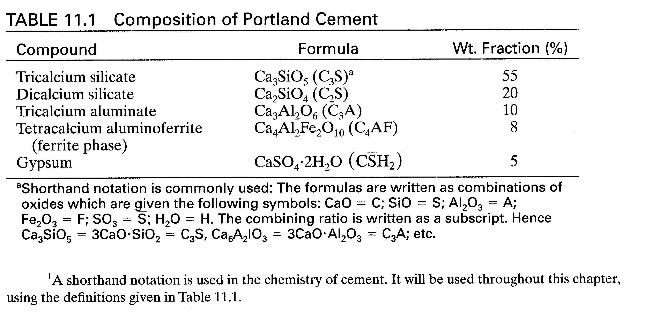
Notes:
Raw materials:
limestone: CaCO₃
Quartz: SiO₂
Clays: Al₂O₃ and Fe₂O₃

Slide 5
Cement Manufacture
Quarrying
Crushing
Mixing
Calcinated (1100°C)
Burned (1450°C)
Clinker is produced (10 mm size)
Inter-ground with 5% gypsum (1-100 μm)
    - most reactive ( <50 μm)

Slide 6



Hydration - Exothermic Reaction
2C₃S + 7H C₃S₂H₈ + 3CH ΔH = -500 J/g
2C₂S + 5H C₃S₂H₈ + CH ΔH = -250 J/g
C₃S or C₂S + water CSH + CH (products 1 & 2)
Amount of CH depends on H₂O
CSH - amorphous in nature, is an inexact composition,
and is extremely fine.

Slide 7
Tricalcium Aluminate (C₃A)
C₃A + H₂O ⇒ reacts very fast
C₃A + H₂O + CSH₂ ⇒ reacts much slower
C₃A + 3C H₂ + 26H ⇒ C₆A ₃H₃₂ ΔH = -1350 J/g
Tricalcium Aluminate + Gypsum + Water
⇒ Ettringite (product #3)
Once C  H₂ is depleted:
C₆A  ₃H₃₂ + 2C₃A + 4H ⇒ 3C₄A  H₁₂
Ettringite + Tricalcium Aluminate + Water
⇒ Monosulfoaluminate (product #4)

Slide 8
Ferrite Phase: C₄AF
Forms same reaction as C₃A but to a lesser degree
Uses small amount of gypsum
C₄AF + 2CH + 14H ⇒ C₄(A,F)H₁₃ + (A,F)H₃
Ferrite + Calcium Hydroxide + Water
⇒ Tetracalcium Hydrate + Ferric Aluminum Hydroxide
(product #5) (product #6)
like monosulfoaluminate amorphous

Slide 9
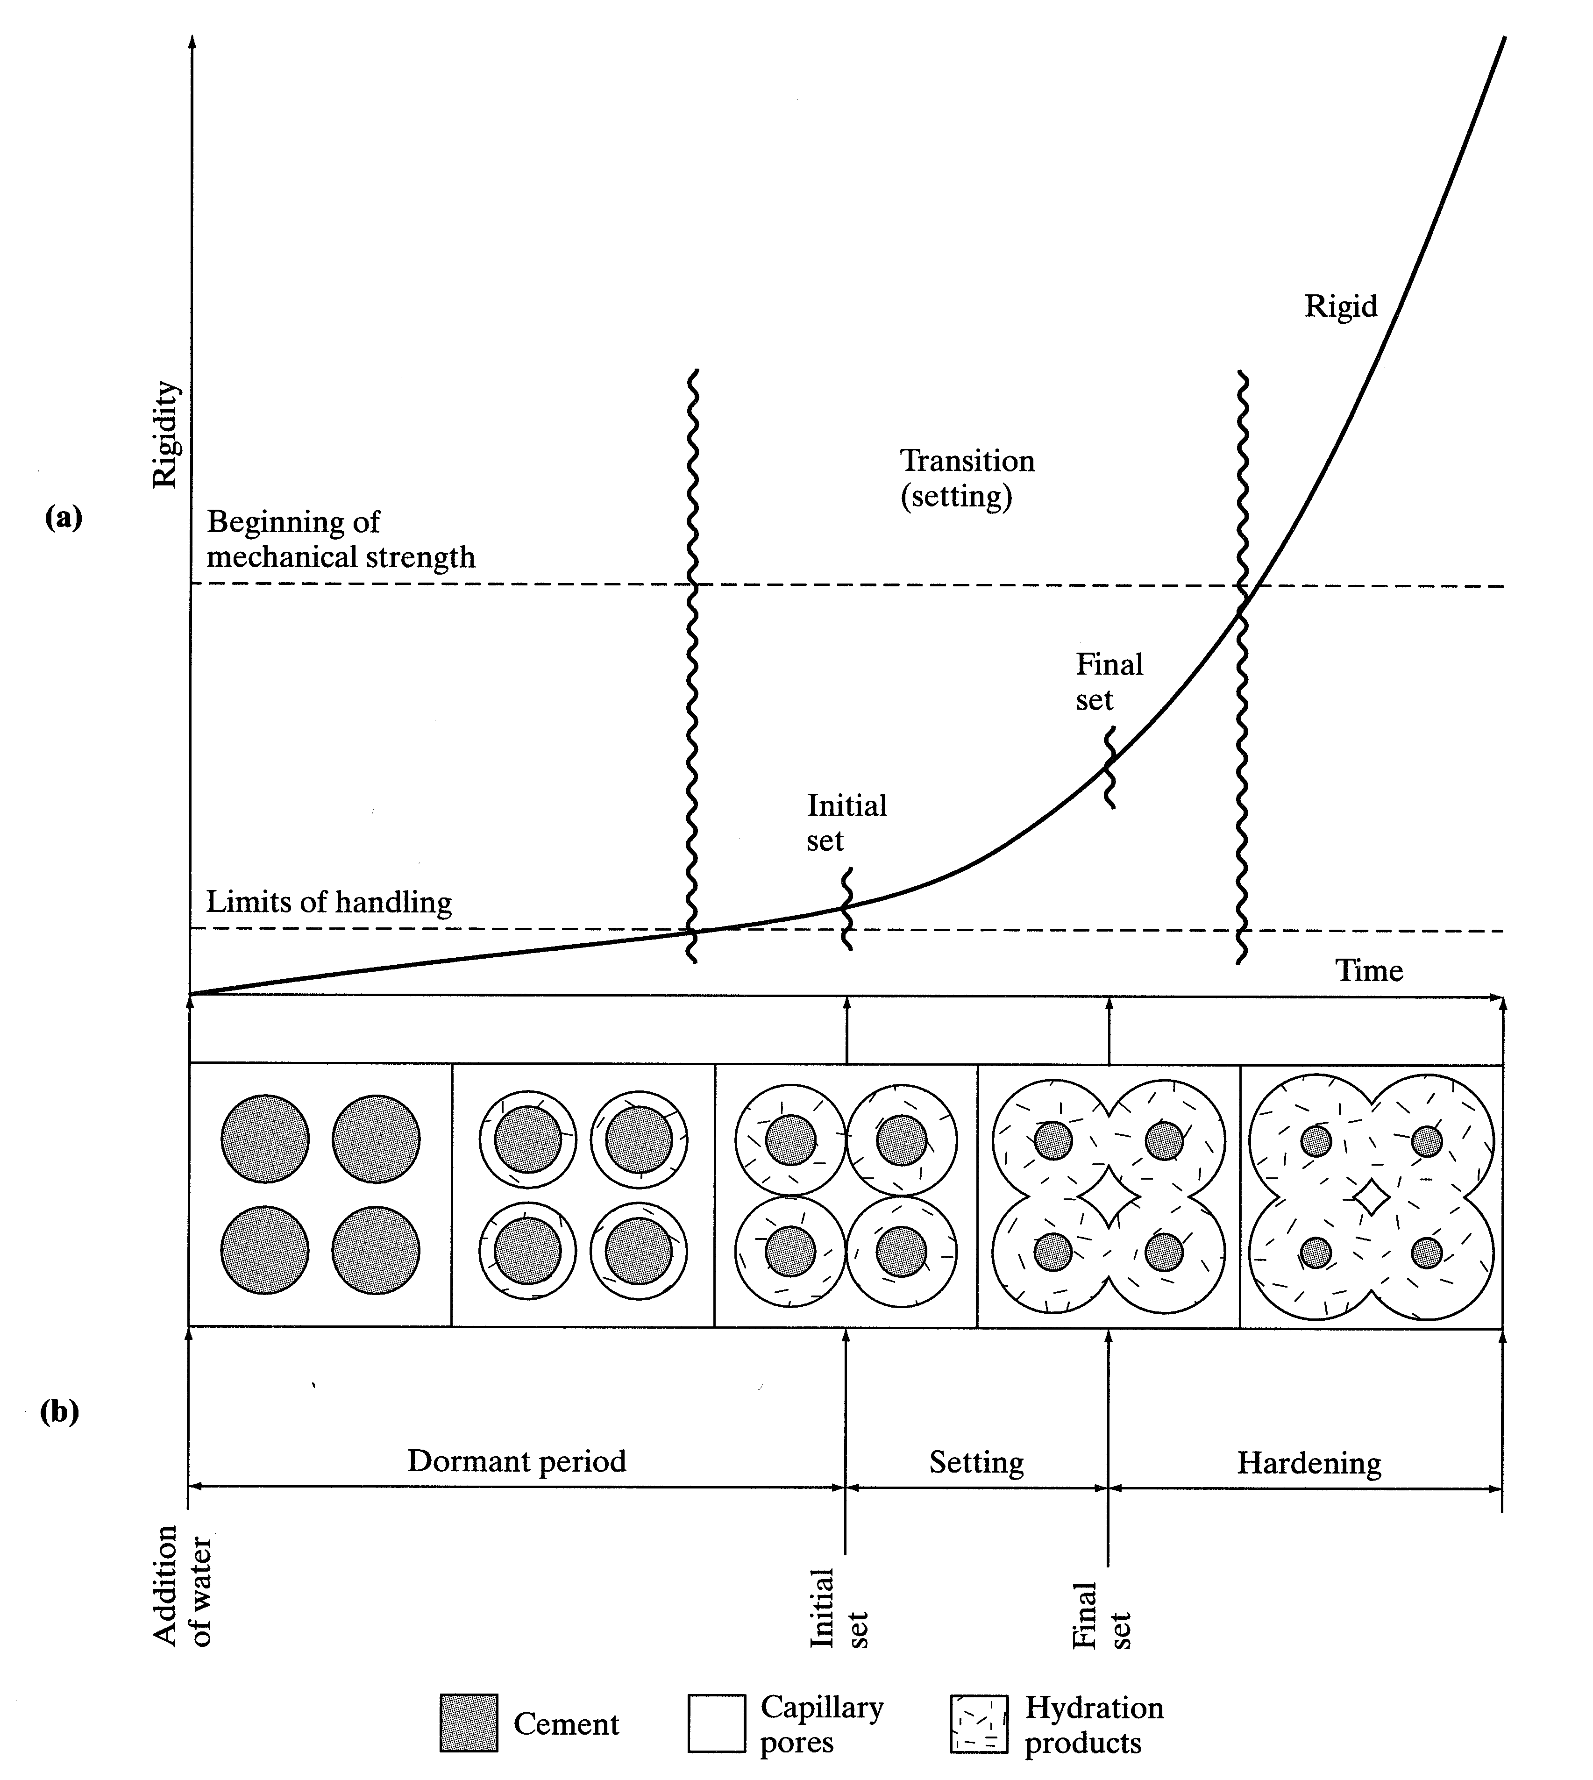
Notes:
Setting and hardening processes
- chemical reaction between water and cement: called hydration
- forms hydration products
1. Mixture is fluid as long as grains are separated.
2. Hydration products grow into pore space.
3. Contact between grains reduces fluidity and constitutes initial setting.
4. Continued hydration results in greater strength but depends on proximity of grains. This constitutes final setting.
5. Hardening stage: significant strength and continuation of drying shrinkage.

Slide 10
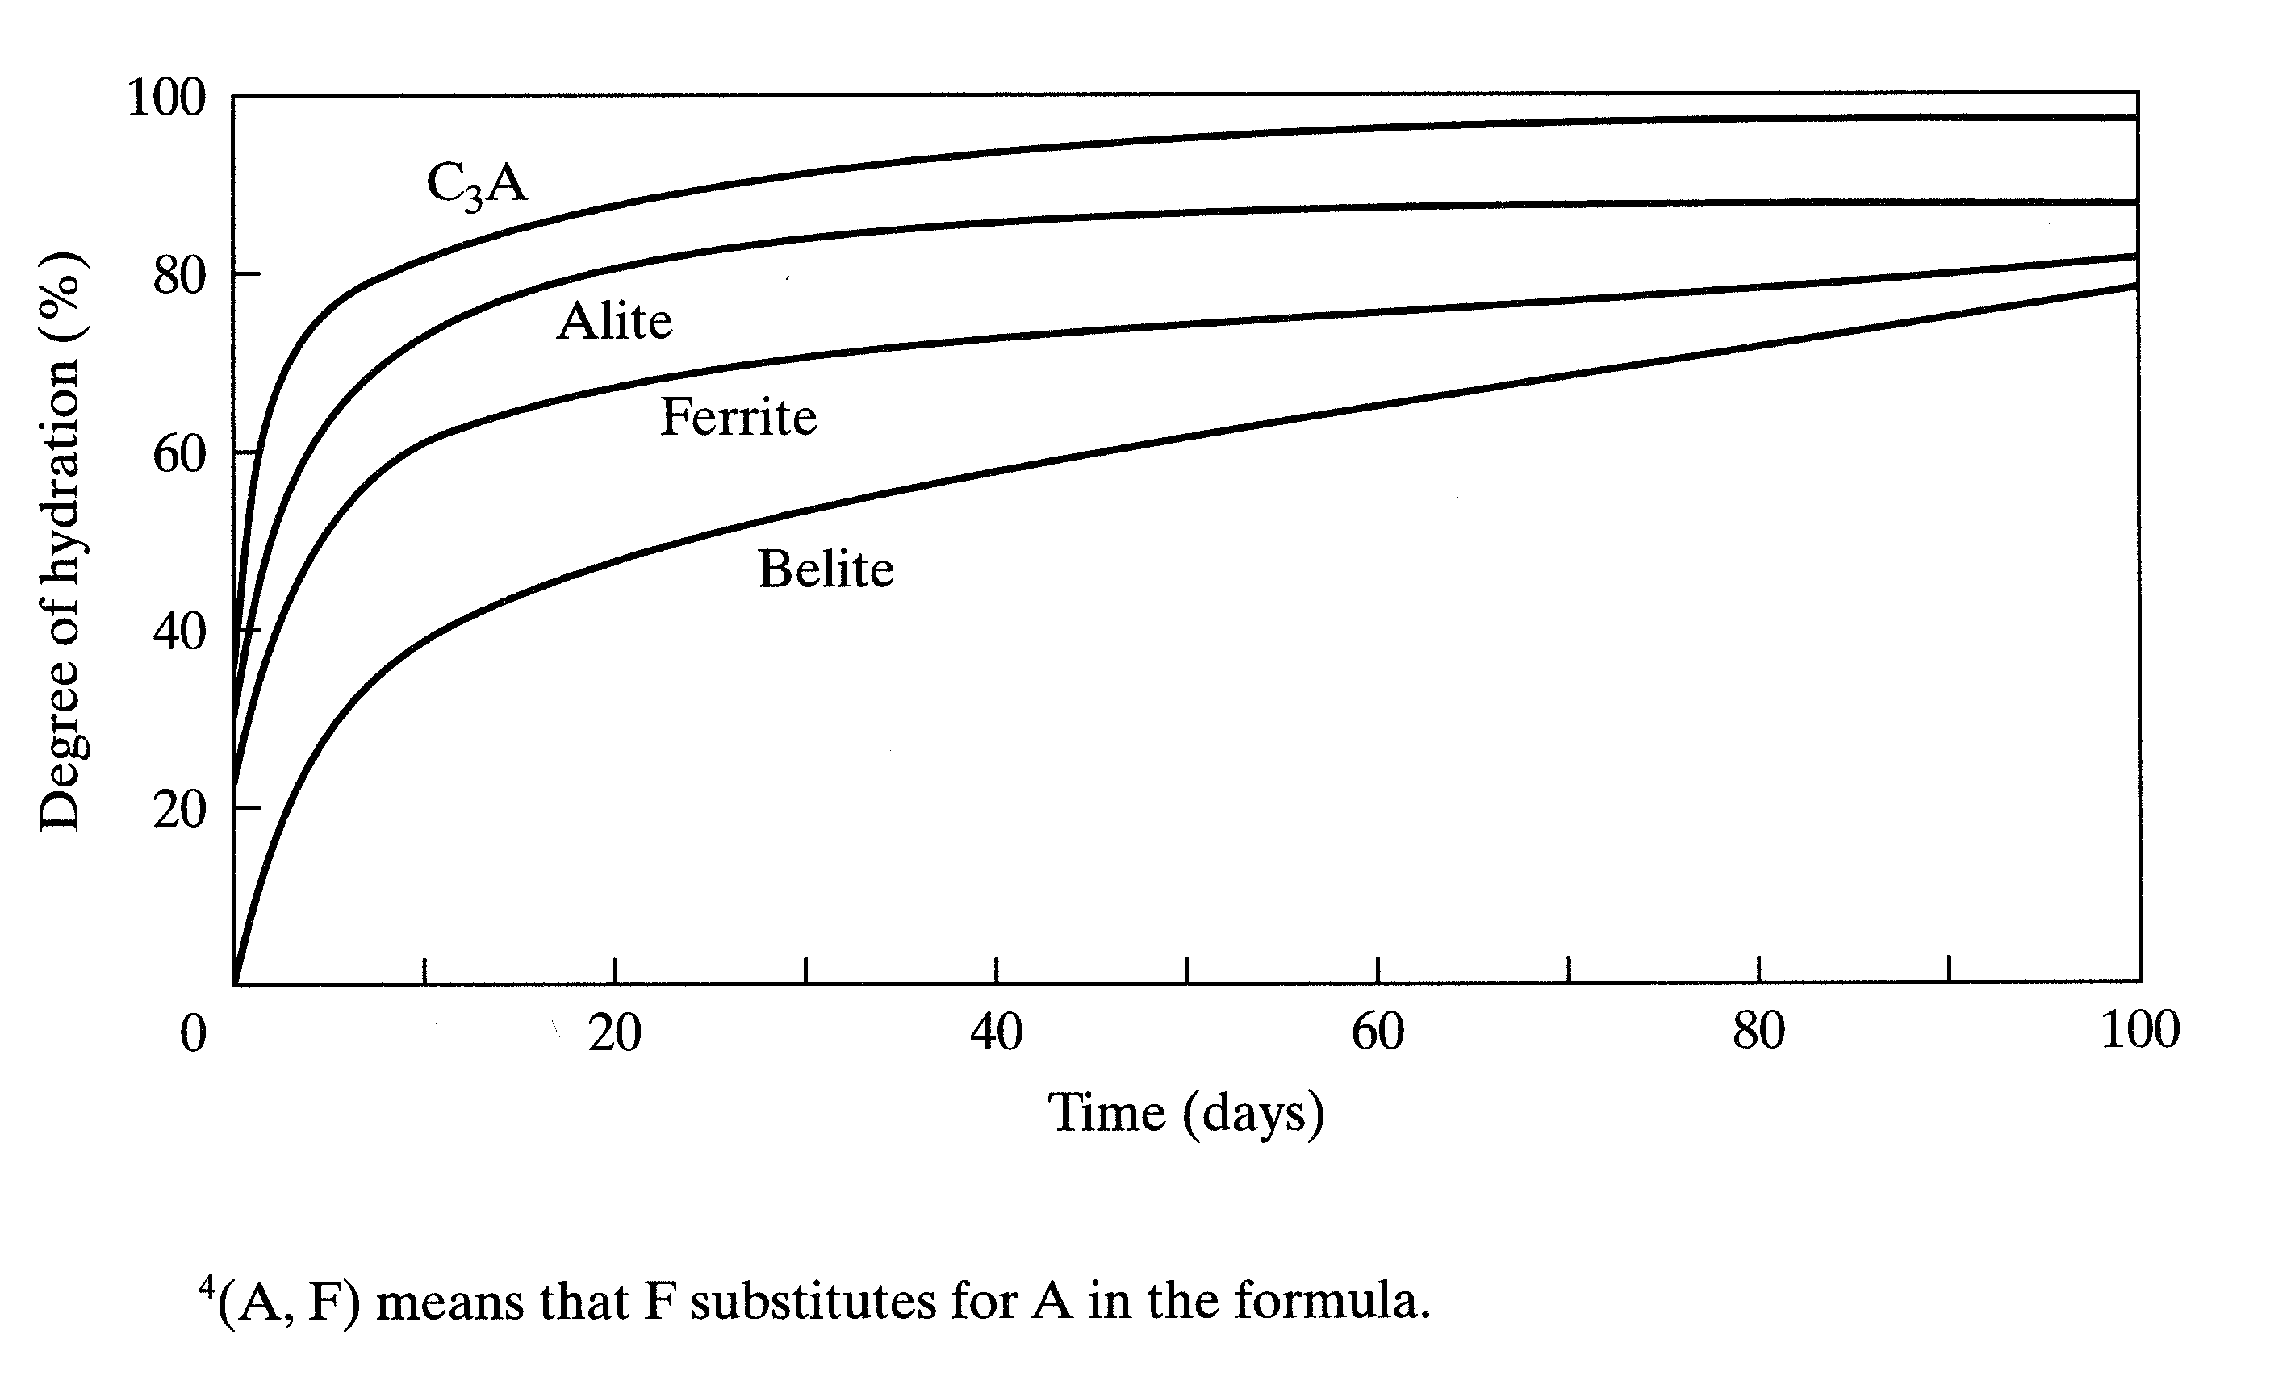
Notes:
Chemical reactions occur at different rates.

Slide 11
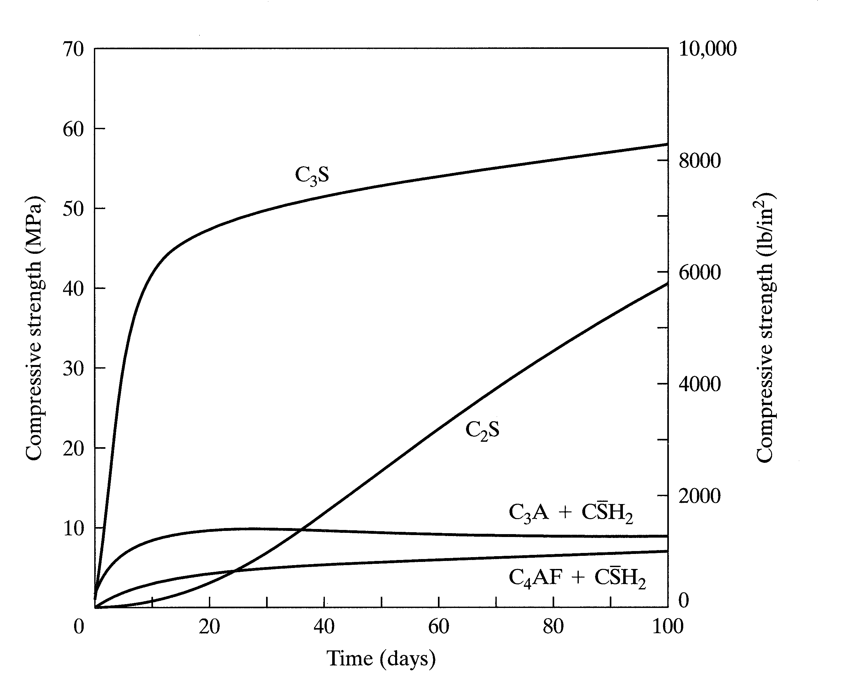
Notes:
C₃S, C₂S contribute mostly to strength which is in the CSH.

Slide 12
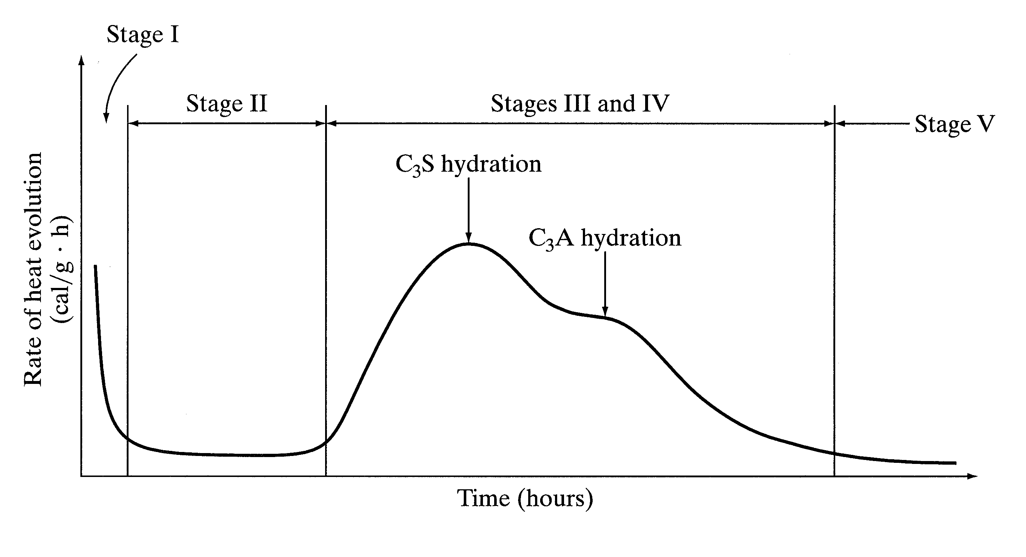
Notes:
Stage 1: Short; heat release due to wetting; initial dissolution
Stage 2: Induction; concrete is workable
Stage 3: Hydration of C₃S; initial and final setting
Stage 4: CH is depleted - C₃A hydrates; CH content is adjusted so C₃A does not occur in Stage 2. (flash setting).
Stage 5: Slow reaction - diffusion based; pore filling
Heat differential through massive placements lead to thermal stresses and cracking.

Slide 13
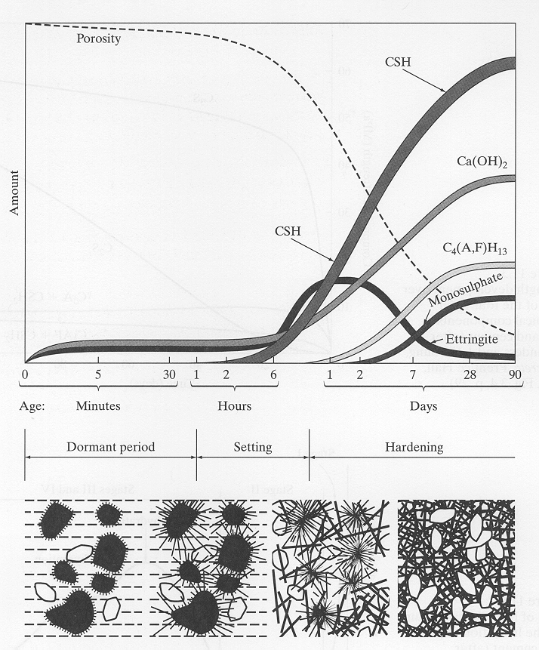
Notes:
Schematic view of reaction products and microstructure during hydration.

Slide 14
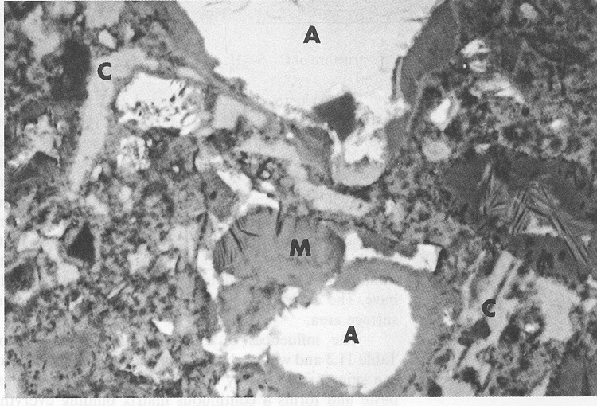
Notes:
SEM of portland cement paste at 28 day age
A - Unhydrated cement - surrounded by dense CSH
M - Monosulfoaluminate
light gray - CH
Dark gray - CSH
Black - porosity (not all space is filled) cement grain
CH
CSH

Slide 15
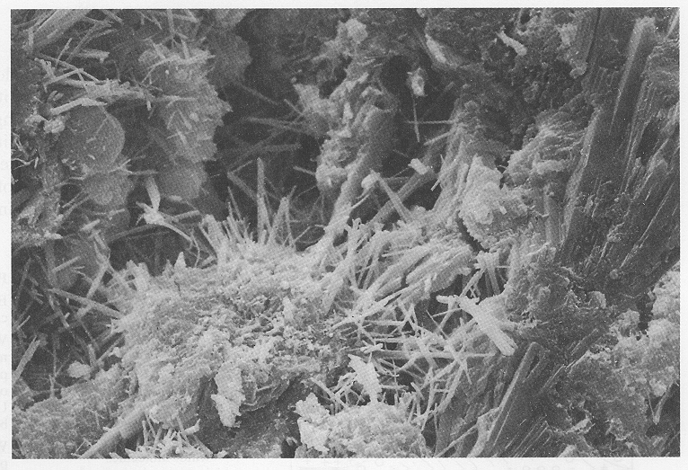
Notes:
SEM of 7-day paste
Note the cement grain, CSH, ettringite, and monosulfoaluminate

Slide 16
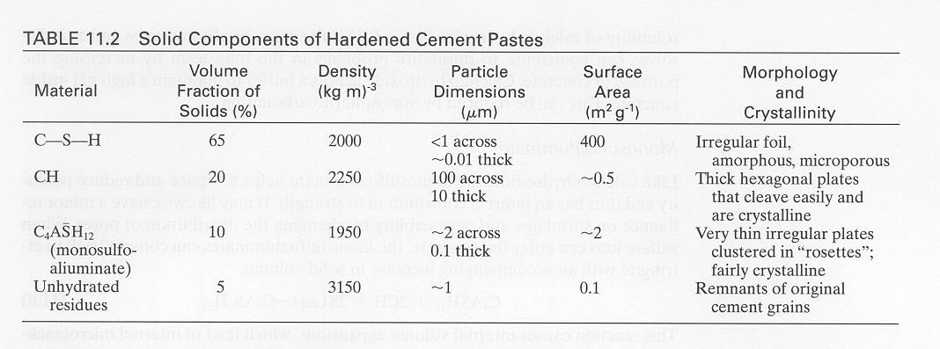
Notes:
Bonding:
35% was hydrogen bonding between sheets (weak)
6% was covalent bonds (strong) Si - O - Si
As water is removed, the C-S sheets collapse and the water content, density, and surface area change
Based on saturated conditions.

Slide 17
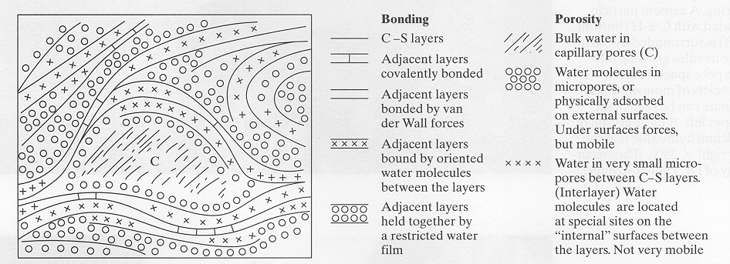
Model of CSH
Notes:
CSH is extremely finely divided
Exact form is unknown
Amorphous and colloidal (surface properties dominate). No regular atomic arrangement
Acts as a space filler

Slide 18
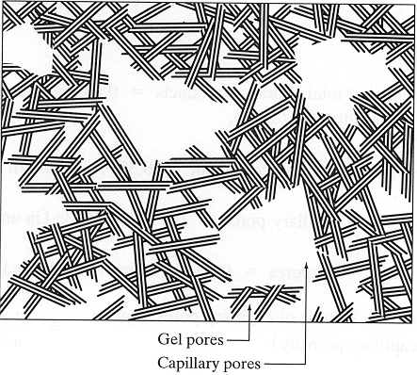
Notes:
Macropores: > 100 nm (0.1 µm)
Mesopores: 2.5 - 100 nm
Micropores; < 2.5 nm

Slide 19
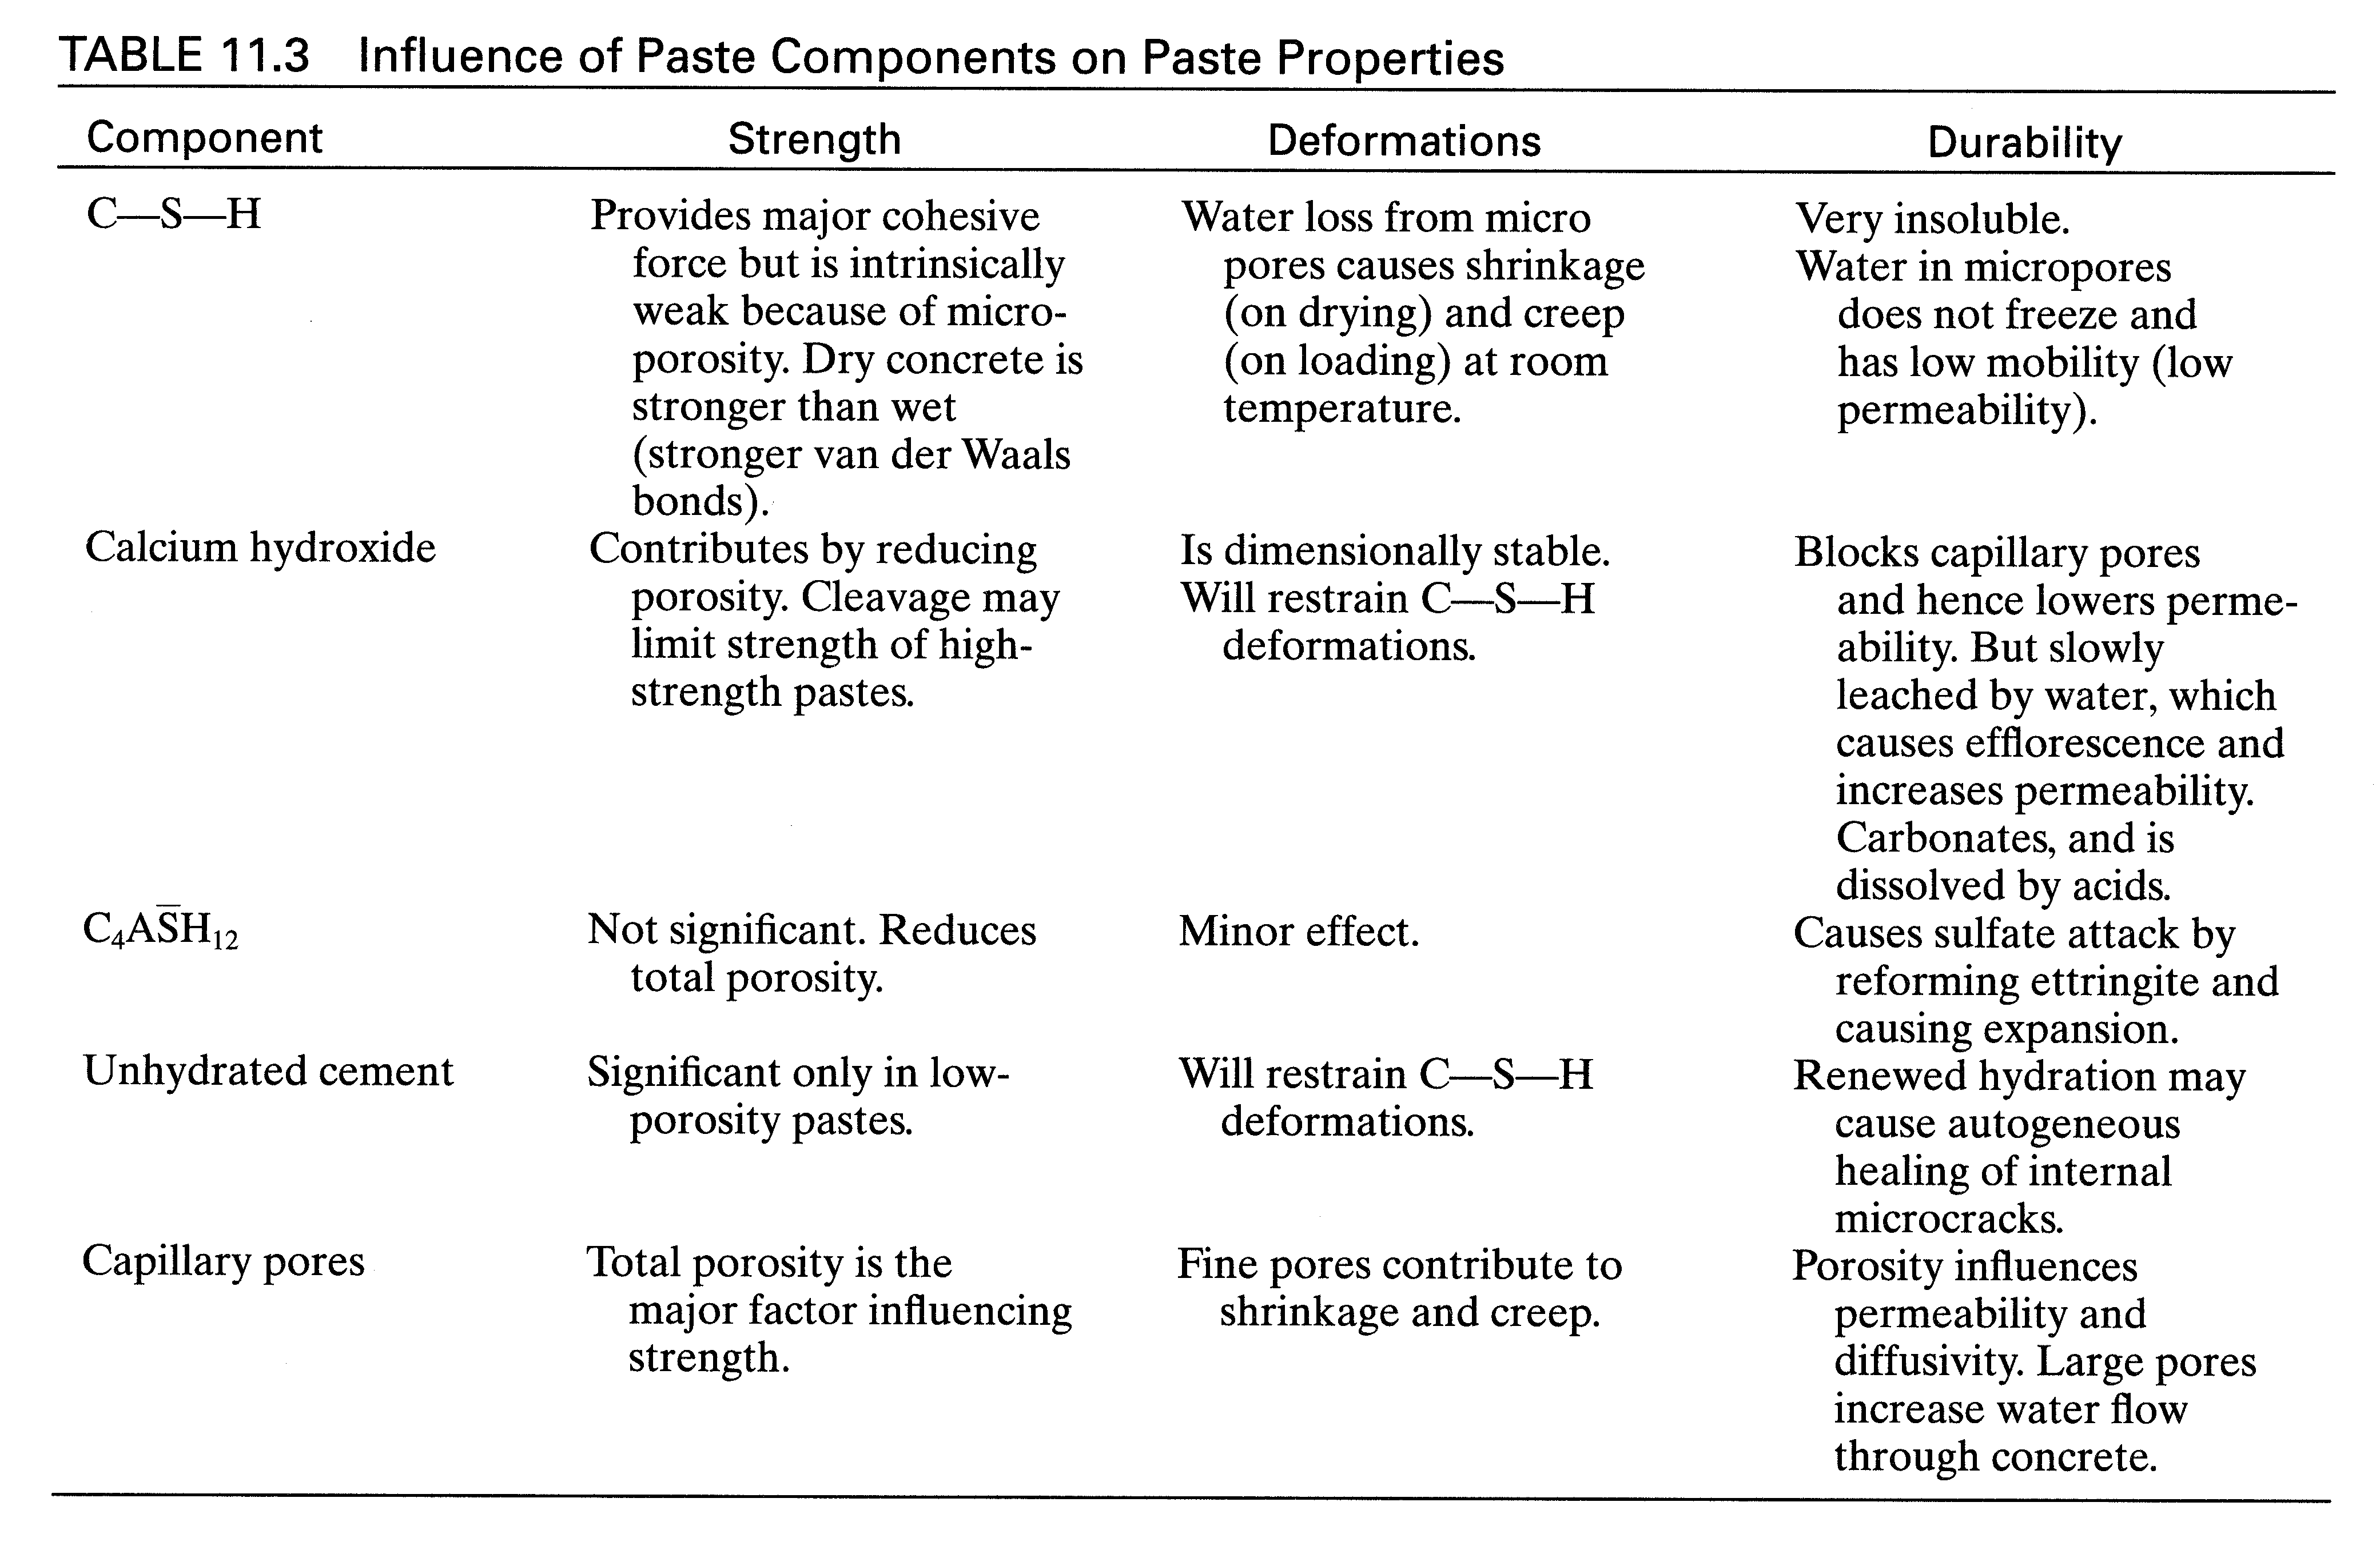
Notes:
CSH structure function of:
Temperature at placement (greater covalent bonds; lower surface area)
w/c (less space available)
CH structure
Well crystallized; large, isolated cystals
Encompass unhydrated cement grain
Soluble in water (causes efflorescence)
Maintains high pH
Fills space and reduces porosity
Monosulfoaluminate
Fills space and reduces porosity
Reacts with sulfate ions
C₄AH₁₂ + 2CH + 2_{(aq)} ⇒ C₆A₃H₃₂
Causes deleterious expansion

Slide 20
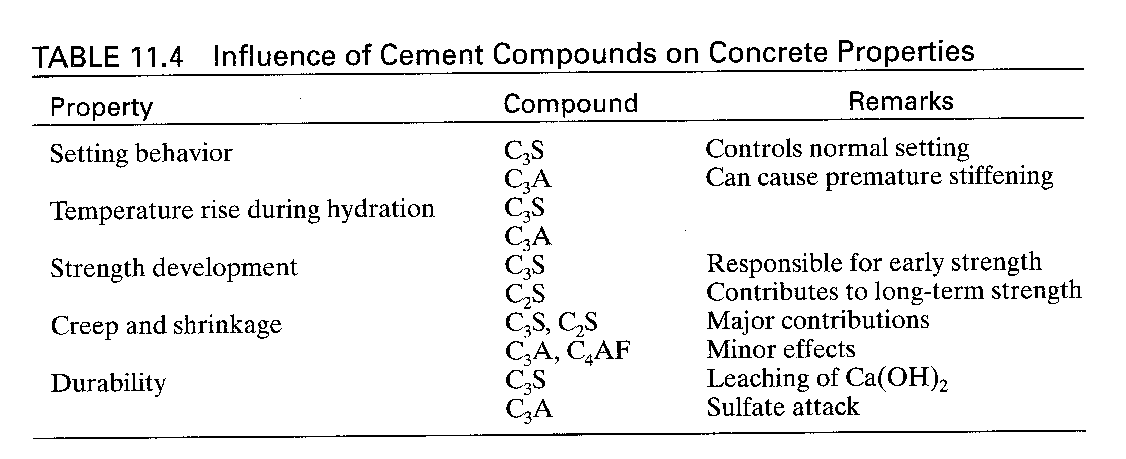
Notes:
Influence of compounds on concrete properties.

Slide 21
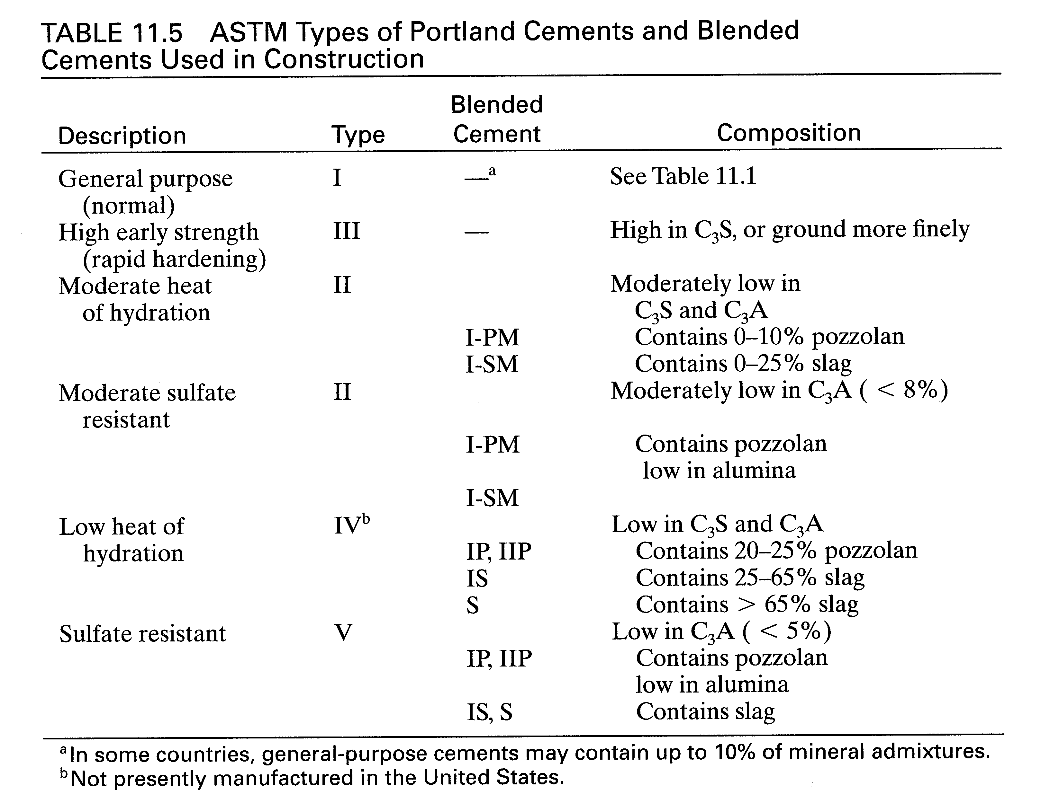
Notes:
Cement Types
Type I General use
Type II Blends of Type I, V, or IV
Type III C₃S up; finer grind; early strength
Type IV C₃S down; C#A down; low heat
Type V C₃A down; low ettringite

Slide 22
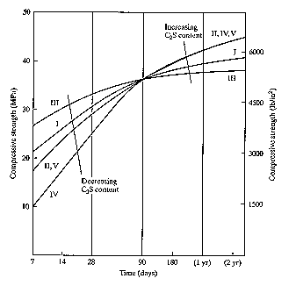

Slide 23
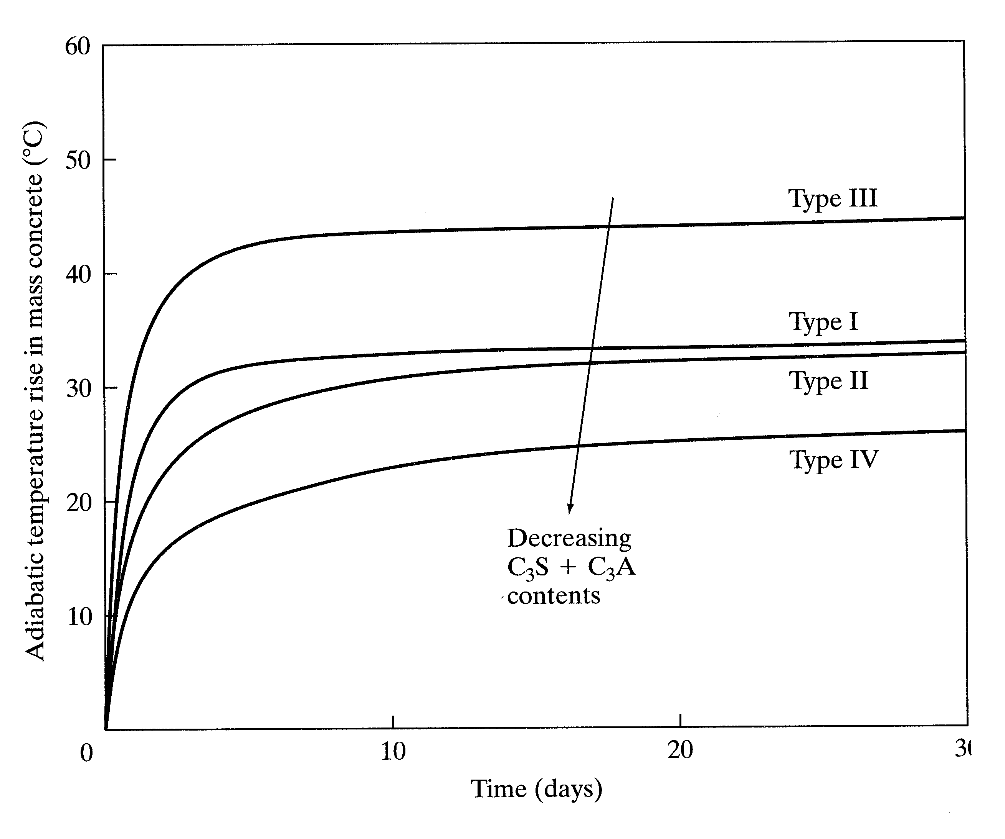

Slide 24
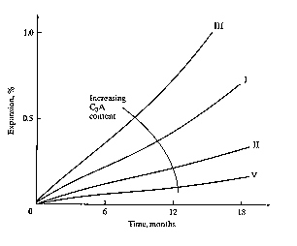

Slide 25
Blended Cements
20 to 70% of total binding material
Total = Cement & supplementary cementitious material
Most mineral admixtures are industrial by products
Use is economical, ecological, or technical in nature
    Fly ash: coal fired power plants
    Blast furnace slag: steel production
      lower heat, improved durability
      lower permeability with same w/c

Slide 26
Pozzolans
2S + 3CH + 7H ⇒ C₃S₂H₈
First used by Romans
CSH is of lower CaO content
Low heat and slow strength gain
Similar to increase in C₂S
Reactivity based on surface area (silica fume)
Some contain alumina (can present durability problems)
Crystalline compounds (quartz); acts to dilutents
Unburned carbon may affect air entrainment
Can have a wide range of composition and reactivity

Slide 27
Blast Furnace Slag
Rapidly cooled slags - to prevent crystallization
(CSA)_{glass} + H ⇒ C₃(SiA)₂H₈ (self - reacting)
Forms alumin substituted CSH
Presence of CH accelerated reaction
Mixed with cement

Slide 28
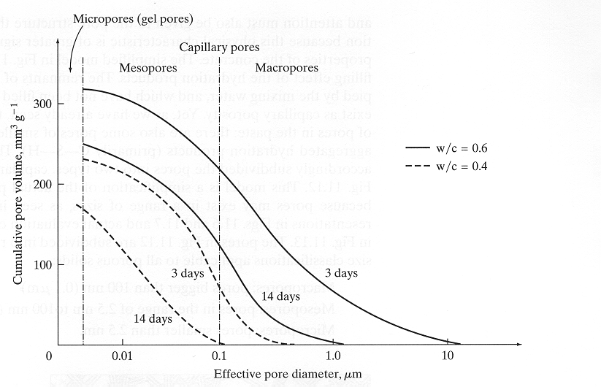
Notes:
Volume of hydrated cement: 0.68αc (includes the gel pores)
Volume of gel pores: 0.18αc
Volume of unhydrated cement: 0.32(1 - α)c
Volume of capillary pores: [w/c - 0.36α]c
Volume of capillary pores + gel pores: [w/c + 0.32α]c
% Capillary Pore Volume: w/c - 0.36α/(w/c + 0.32α)

Slide 30
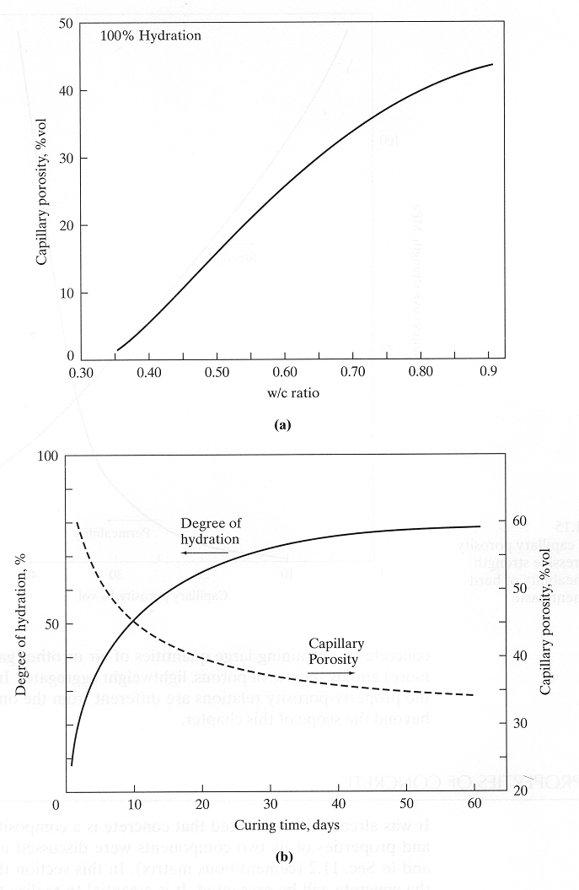
Notes:
w/c controls the porosity of hardened cement paste.

Slide 31
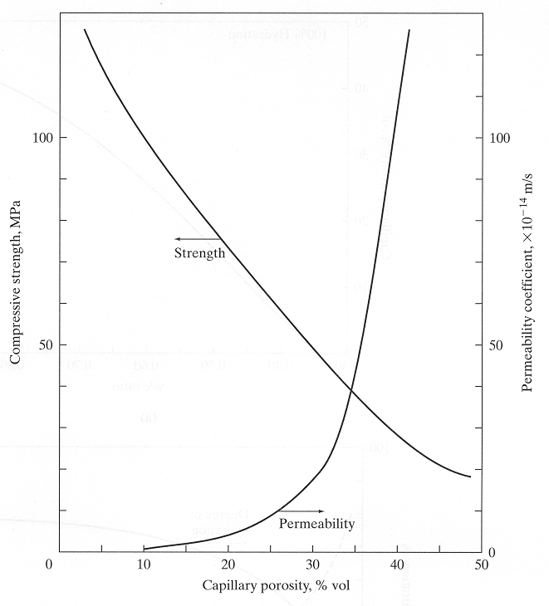
Notes:
High quality control consists of low w/c and permeability.
A low w/c and adequate curing are key elements in concrete technology. A particularly low w/c can be achieved in mixes with HRWR’s and very fine pozzolans such as silica fume. These mixtures achieve compressive strength levels in the range of 50 to 130 MPa.

Slide 33


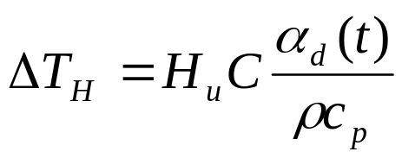
Temperature Increase
T
Time
Total Heat/g
Cement Content
Degree of Hydration
Specific Heat
Density

